Slide 1
ANDROID PERMISSIONS Part 2

Slide 2
Requesting Permissions
Requesting permission can be done in two ways.
Requesting Permission by yourself: Traditional Approach
Requesting Permission by System: Recommended Approach

Slide 3
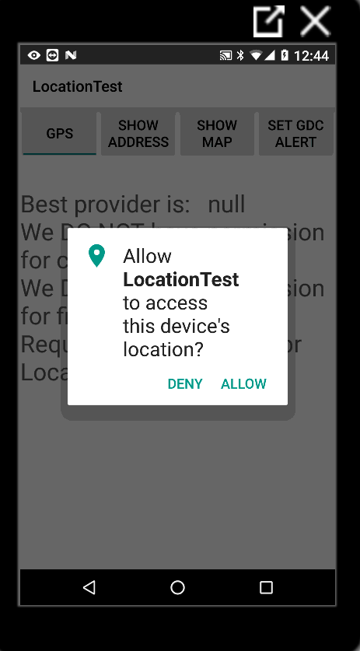
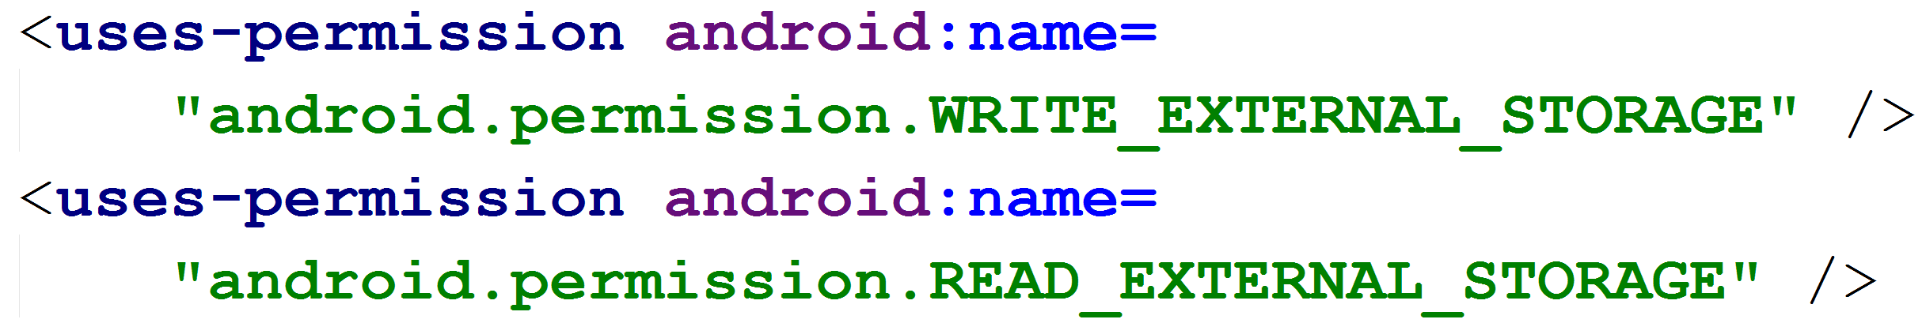
Requesting Permissions: General format
First, declare permissions in app’s manifest
When app needs dangerous permission
Check to see if you already have permission
If not call one of the requestPermission methods with desired permissions and request code
requestPermission shows a standard, non modifiable dialog box to the user

Slide 4
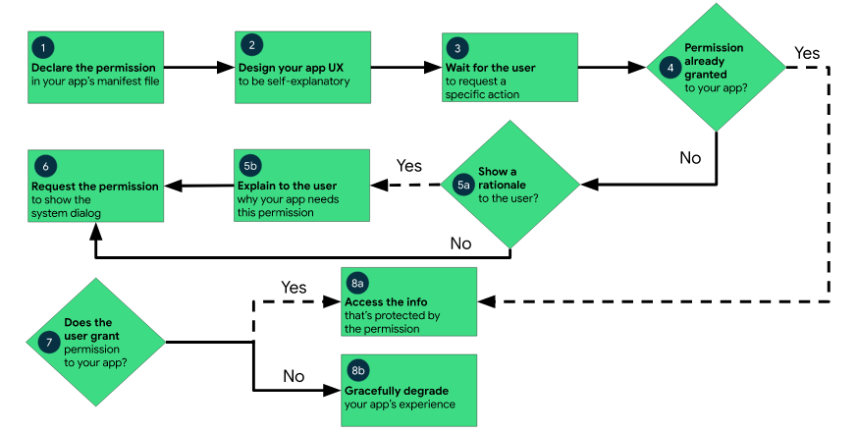
Requesting Permissions: General format

Slide 5
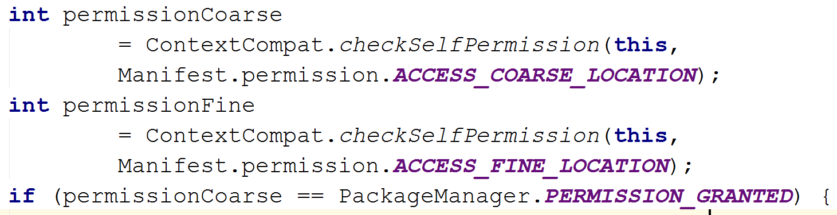
Requesting Permissions: By yourself
Checking Permissions: Before Requesting a Permission, check to see if you already have it.
To check if the user has already granted your app a particular permission, pass that permission into the ContextCompat.checkSelfPermission() method. This method returns either PERMISSION_GRANTED or PERMISSION_DENIED, depending on whether your app has the permission.
Requested Permission

Slide 6
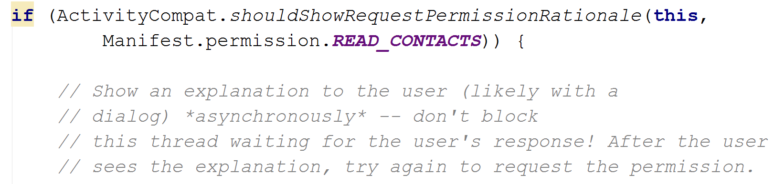
Requesting Permissions: By yourself
Explain why your app needs permission: If the ContextCompat.checkSelfPermission() method returns PERMISSION_DENIED, call shouldShowRequestPermissionRationale().
If this method returns true, show an educational UI to the user. In this UI, describe why the feature, which the user wants to enable, needs a particular permission.
else if
shouldShowRequestPermissionRationale returns true if the app previously requested the permission and the user denied it

Slide 7
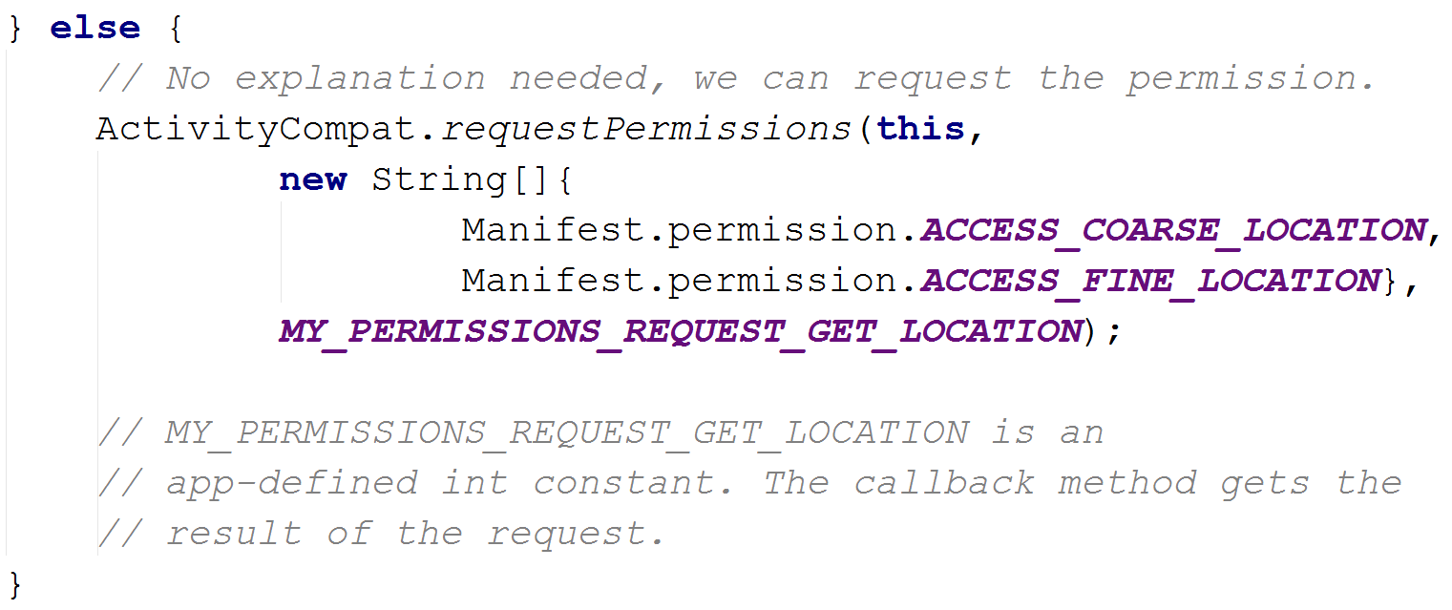
Requesting Permissions: By yourself
Requesting permission: If user has not previously denied permission then request the permission. Users see a system permission dialog, where they can choose whether to grant a particular permission to your app.
Requested Code

Slide 8
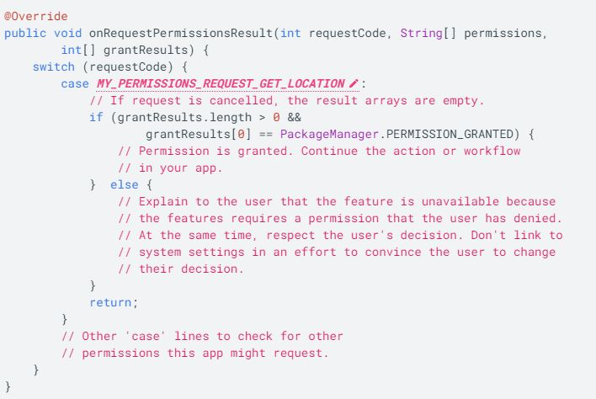
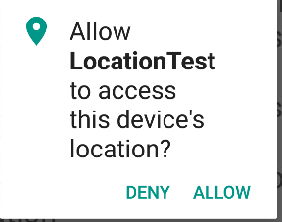
Requesting Permissions: By yourself
Dialog box: Dialog displayed to user. Lists permission group, not individual permissions.
After the user responds to the system permissions dialog, the system then invokes your app's implementation of onRequestPermissionsResult().
The system passes in the user response to the permission dialog, as well as the request code that you defined.

Slide 9
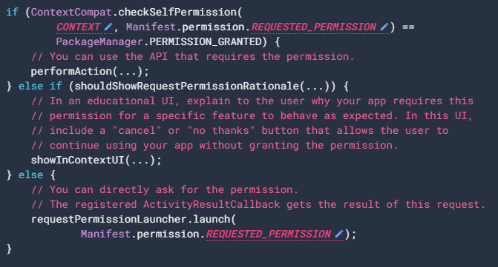
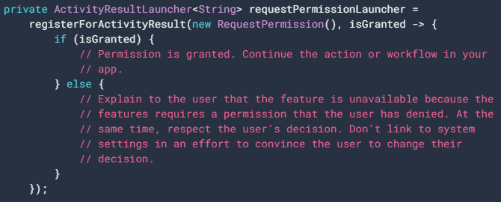
Requesting Permissions: By System
To allow the system to manage the request code that's associated with a permissions request, add a dependency on the androidx.activity or androidx.fragment library in your module's build.gradle file.
Here the System controls the response of the user through the registerForActivityResult() instead of the onRequestPermissionsResult().

Slide 10
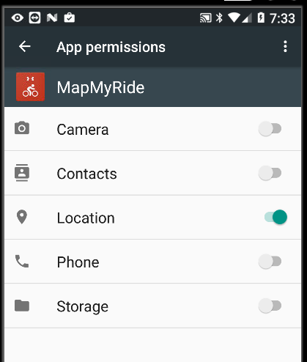

App Permissions Notes
If you use an intent to accomplish something, then your app does not usually have to request permission
For example, if you use an Intent to take picture, you DO NOT need CAMERA permission. • Only if you want to access camera directly in your app. • Example, CAM Scanner, SMS
A user can also alter permissions in the Settings app • Settings -> app • Toggle Switches to grant and deny permissions

Slide 11
App Permissions Best Practices
Only use the permissions necessary for your app to work. Depending on how you are using the permissions, there may be another way to do what you need (system intents, identifiers, backgrounding for phone calls) without relying on access to sensitive information.
Pay attention to permissions required by libraries. When you include a library, you also inherit its permission requirements. You should be aware of what you're including, the permissions they require, and what those permissions are used for.
Be transparent. When you make a permissions request, be clear about what you’re accessing, and why, so users can make informed decisions..
Make system accesses explicit. Providing continuous indications when you access sensitive capabilities (for example, the camera or microphone) makes it clear to users when you’re collecting data and avoids the perception that you're collecting data surreptitiously.
https://developer.android.com/training/permissions/usage-notes: Alternatives for App Permissions

Slide 12
THANK YOU

